Slide 1
CIS 200 Algorithm Analysis: An Introduction
26 July 2018
Jeffrey J. Yackley

Slide 2
Outline
Introduction to Algorithm Analysis
Start at the beginning: What is an algorithm?
Importance of Efficient Algorithms
Algorithm Analysis: Determining Efficiency
Determining the Order

Slide 3
What is a problem?
A problem is a question to which we seek an answer
Examples:
Sort a list S of n numbers in non-decreasing order [sort]
Determine whether the number x is in the list S of n numbers [search]
A problem contains parameters which are variables that are not assigned specific values
Examples:
S, n in the sort problem
x, S, n in the search problem

Slide 4
What is an instance of a problem ?
Because a problem contains parameters, it represents a class of problems
Each specific assignment of values to the parameters is called an instance of the problem
Example:
Sort: S = [10, 7, 11, 5, 13, 8] and n=6
Search: S = [10, 7, 11, 5, 13, 8], n=6, x=5

Slide 5
What is an algorithm?
A problem can have many instances
To produce a computer program that can solve all instances of a problem, we must specify a general step-by-step procedure for producing the solution to each instance
This step-by-step procedure is called an algorithm
We say that the algorithm solves the problem.

Slide 6
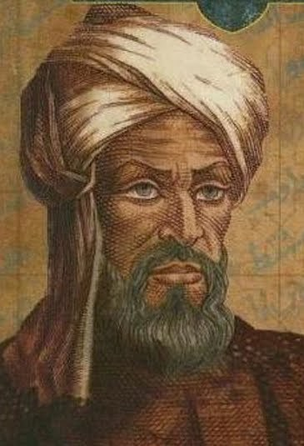
What is an algorithm? CompSci History Aside!
Algorithm: comes from the name of the great mathematician:
Muhammad Al-Khwarizmi
Father of Algebra
Algorithm name after him
Al-Khwarizmi -> Algoritmi -> Algorithm
An algorithm is a set of instruction for solving a problem.
How do we write an algorithm?
Like a recipe! One step at a time.

Slide 7
An Example: Sequential Search
Search Problem: determine whether the number x is in the list S of n numbers
A simple approach to solve the search problem is to do sequential search, i.e.,
Start from the leftmost element of S and one by one compare x with each element of S
If x matches with an element, return the index.
If x doesn’t match with any of elements, return -1.

Slide 8
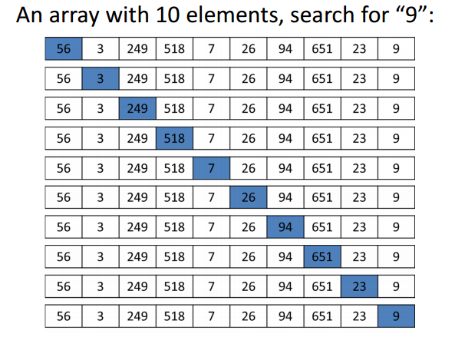
An Example: Sequential Search

Slide 9
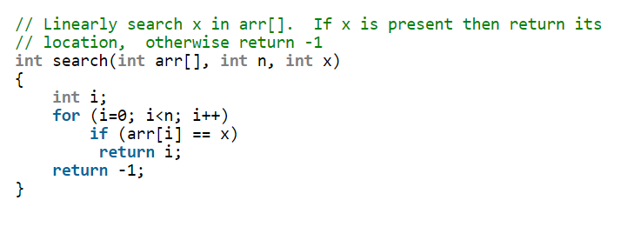
An Example: Sequential Search
http://www.geeksforgeeks.org/linear-search/

Slide 10
Outline
Introduction to Algorithm Analysis
Start at the beginning: What is an algorithm?
Importance of Efficient Algorithms
Algorithm Analysis: Determining Efficiency
Determining the Order

Slide 11
Why are efficient algorithms important?
Sequential Search
If x is NOT in the list, n comparisons
If x is in the list, <n comparisons

Slide 12
Binary Search
Search a sorted array by repeatedly dividing the search interval in half
Begin with an interval covering the whole array
If the value of the search key is less than the item in the middle of the interval, narrow the interval to the lower half
Otherwise narrow it to the upper half
Repeatedly check until the value is found or the interval is empty

Slide 13
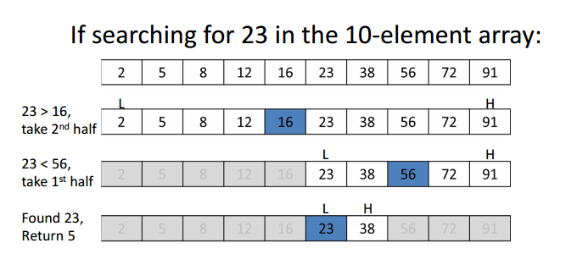
Binary Search: An Example

Slide 14
A Comparison of Comparisons
Array size | Sequential Search | Binary Search
128 | 128 | 8
1,024 | 1,024 | 11
1,048,576 | 1,048,576 | 21
4,294,967,296 | 4,294,967,296 | 33

Slide 15
Outline
Introduction to Algorithm Analysis
Start at the beginning: What is an algorithm?
Importance of Efficient Algorithms
Algorithm Analysis: Determining Efficiency
Determining the Order

Slide 16
Time Complexity Analysis
To analyze the efficiency of an algorithm in terms of time:
We DO NOT want to use the number of CPU cycles
As this depends on the particular computer one uses to run the algorithm
We DO NOT want to count every instruction executed
As it depends on the programming language used to implement the algorithm and the way the programmer writes the program
We want a measure that is independent of the computer, the programming language, the programmer, and all the complex details of the algorithm (i.e., an incrementing of loop indices, setting of pointers, etc.)

Slide 17
Time Complexity Analysis
In general:
The running time of an algorithm increases with the size of input
The total running time is roughly proportional to how many times some basic operation is done
Therefore, we analyze the algorithm’s efficiency by determining the number of times some basic operation is done as a function of the size of the input
Input size, n:
Array size S[n]
Matrix size n*n
A graph (V, E)

Slide 18
What is a basic operation?
We can count lines of ‘algorithmic code’ actually executed
Some lines take more time than others
We can count the number of arithmetic operations
Some operations take longer than others
Each operation is not a constant time
Time for addition is directly proportional to the sum of the number of bits of each number
Time for multiplication is directly proportional to the product of the numbers of bits of each number

Slide 19
What is a basic operation?
In general, we count the number of operations which cost the most
In a problem having additions and multiplications, we can count the number of multiplications
Various operations are assumed to take constant time

Slide 20
What is a basic operation?
In general, we count the number of operations which cost the most
In a problem having additions and multiplications, we can count the number of multiplications
Various operations are assumed to take constant time
Time complexity analysis
How many times the basic operation is done for each value of the input size

Slide 21
Time Complexity
Time complexity analysis
How many times the basic operation is done for each value of the input size
Time complexity depends not only on the input size but the input value
e.g., in Algorithm 1.1 (Sequential Search), if x appears in the first term of S, the basic operation is done once
e.g., In Algorithm 1.2 (Add Array Members), the basic operation is always done the same number of times

Slide 22
Terminology
T(n): every-case time complexity analysis
The number of times the algorithm does the basic operation for an instance of size n
W(n): worst-case time complexity analysis
The maximum number of times the algorithm will ever do the basic operations for an input of size n
if T(n) exists T(n) = W(n)
A(n): average-case time complexity analysis
The average (expected) number of times the algorithm will ever do the basic operations
if T(n) exists, T(n) = A(n)
Assign probability to all possible inputs of size
usually, assume each slot is equally likely
B(n): best-case time complexity analysis
The minimum number of times the algorithm will ever do the basic operations
if T(n) exists, T(n) = B(n)

Slide 23
Terminology
Average-case A(n):
Tell us how much time the algorithm would take when used many times on many different inputs.
Worst-case W(n):
Give us an upper bound on the time taken by the algorithm.
e.g., the response time in a nuclear power plant
Best-case B(n):
Give us an lower bound on the time taken by the algorithm, little values

Slide 24
Time/Space Complexity
Which is most often used?
Best-case
Average-case
Worst-case

Slide 25
Time/Space Complexity
Best-case
Not used much
Average-case
Usually hard to compute
Worst-case
This is what is used most often

Slide 26
Time/Space Complexity Examples
Complexity function: f(n): N->R
Example time complexity functions:
f(n) = n
f(n) = n²
f(n) = lg n
f(n) = 3n² + 4n

Slide 27
Outline
Introduction to Algorithm Analysis
Start at the beginning: What is an algorithm?
Importance of Efficient Algorithms
Algorithm Analysis: Determining Efficiency
Determining the Order

Slide 28
Determining Efficiency
An algorithm with a time complexity of n is more efficient than one with a time complexity of n² for sufficiently large value of n
0.01n² > 100n -> when n < 10,000, the first is faster than the second
when n > 10,000, the first is slower than the second
Linear-time algorithms
the algorithms with time complexity such as n, 100n
Quadratic-time algorithms
the algorithms with time complexity such as n², 0.01n²
Principle: A linear-time algorithm is faster than a quadratic time algorithm, eventually

Slide 29
An Introduction to Order
pure quadratic function
5n², 5n²+100
complete quadratic function
0.1n²+n+100
quadratic term eventually dominates functions
Complete quadratic functions will be classified into pure quadratic functions
We can always throw away low-order terms when classifying complexity functions:
0.1n³+10n²+5n+25 →pure cubic functions

Slide 30
An Introduction to Order
θ(n²):
a set of functions which are pure quadratic
i.e., g(n)=5n²+100n+20 ∈ θ(n²)
When an algorithm’s time complexity is θ(n²), it is called as a
θ(n²) algorithm
Common complexity categories:
θ(lgn) , θ(n), θ(nlogn), θ(n²), θ(n³), θ(2^{n})

Slide 31
A Rigorous Introduction to Order
Big-O Definition
For a given complexity function f(n), O(f(n)) is the set of complexity functions g(n) s.t.
∃ (some real positive constant c) and
(some nonnegative integer N)
g(n) ≤ c × f(n), for all n ≥N
g(n) ∈O(f(n)), we call g(n) to be big O of f(n).

Slide 32
Big-O Notation
Instead of saying that an algorithm has a running time (time-complexity) of 5N³-2N²+8.4N-5.6, we say it is O(N³)
Why????
Because only the highest-growing terms are important and affect the running time as N → ∞
Big-O is used to describe the asymptotic behavior of a function because they are concerned only with eventual behavior

Slide 33
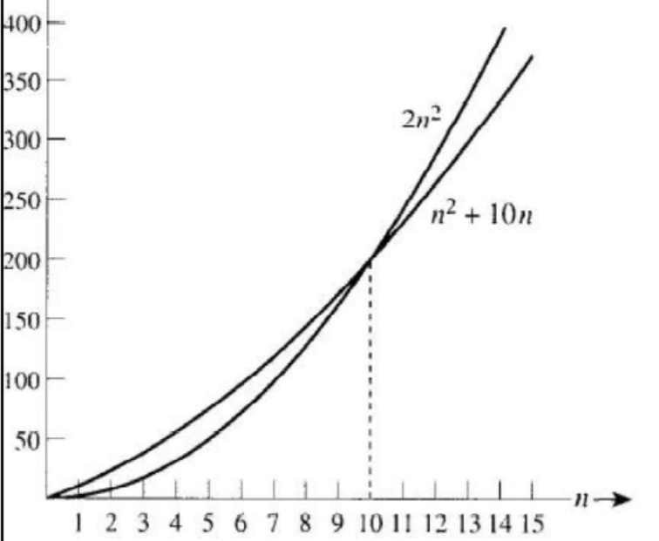
Big-O Notation
n²+10n ≤ 2×n² for n ≥10
∴ take c=2 and N=10
n²+10n ∈ O(n²)
Big-O puts an asymptotic upper bound on a function

Slide 34
Ω notation – lower bound
Ω Definition
For a given complexity function f(n), Ω(f(n)) is a set of complexity functions g(n) s.t.
∃ (some real positive constant c) and
(some nonnegative integer N )
g(n) ≥ c × f(n), for all n ≥N
g(n) ∈Ω(f(n)), we call g(n) to be Omega of f(n)
Omega gives an asymptotic lower bound on a function.
at least as bad as f(n)

Slide 35
Θ notation
Definition
For a given complexity function f(n)
θ(f(n))= O(f(n)) ∩Ω(f(n))
means a set of g(n) s.t.
∃ (some real positive constants c, d) and
(some nonnegative integer N)
c × f(n) ≤ g(n) ≤ d × f(n) for all n ≥N
If g(n) ∈θ(f(n)), we call g(n) to be Order of f(n).

Slide 36
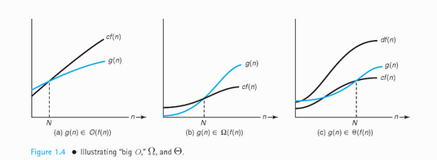
Examples

Slide 37
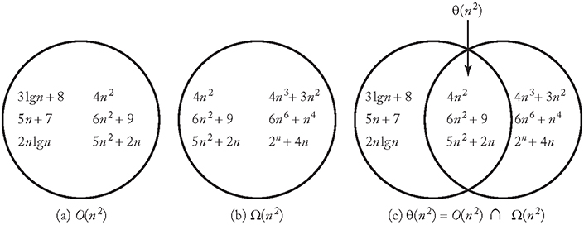
Examples

